Slide 1

Hornet 7.0 Software Workshop #2

Slide 2
Sensors

Slide 3
What are sensors?
“a device that responds to a physical stimulus and transmits a resulting impulse”
Stimulus
Sensor
Signal

Slide 4
Why do we need sensors?
To locate ourselves and navigate
To understand our environment
To detect failure
To control our vehicle

Slide 5
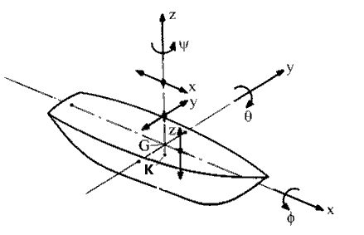
Location
Location is normally described as a pose which consists of:
(x,y,z) co-ordinates (a.k.a heave,surge, sway)
Roll, pitch and yaw (describes orientation)

Slide 6
Position

Slide 7
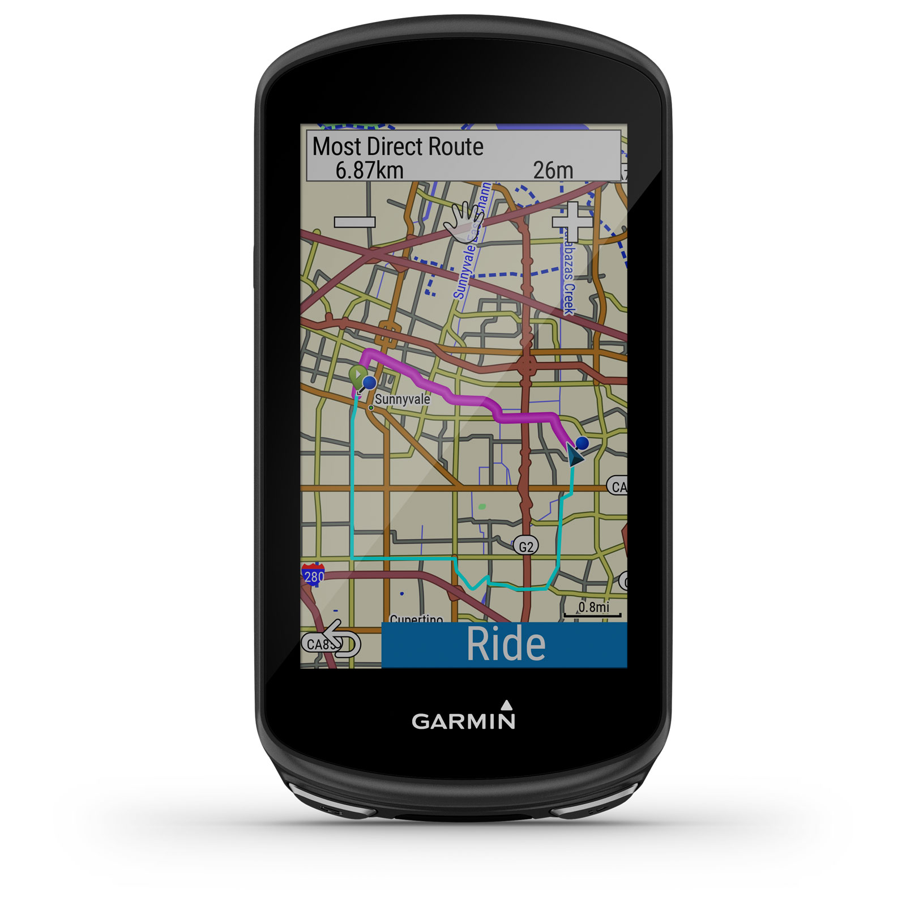


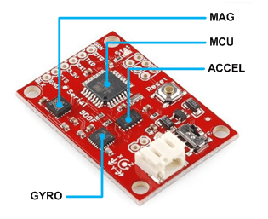
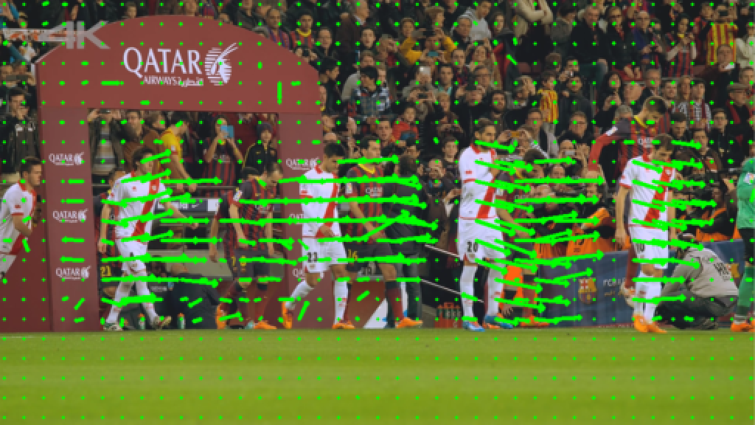
Locating ourselves underwater

Slide 8
Inertial Measurement Unit
IMU
Combination of :
Accelerometer
Gyroscope
Magnetometer

Slide 9
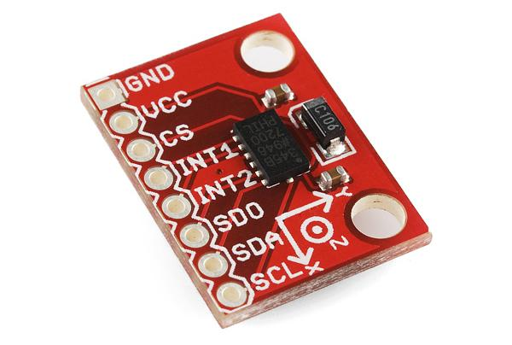
Accelerometer
Measures acceleration in the x,y,z axis
s = ∫ v dt = ∬ a dtdt〗^2 dt〗^2 a= s = dv/dt=(dS^2)/〖dt〗^2
Can be used to measure gravity
Double integral causes drift

Slide 10
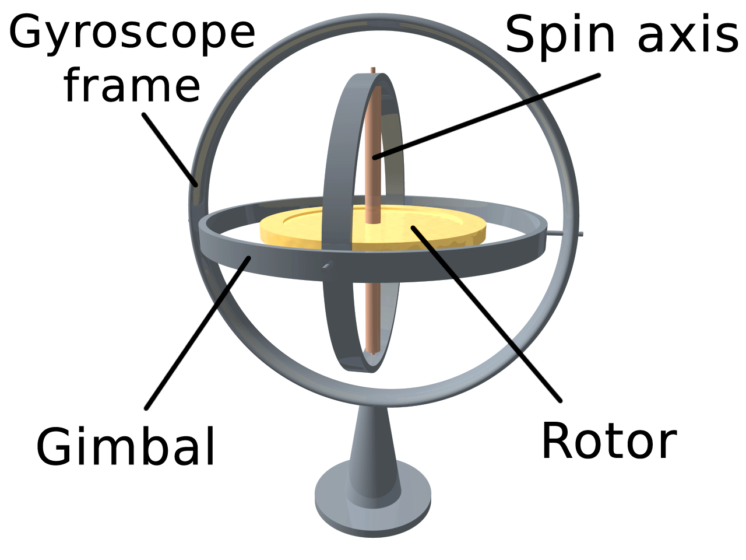
Gyroscope
Measures angular velocity
Can be used to correct for rotation as compass can respond slowly
Responds quickly
Has drift

Slide 11
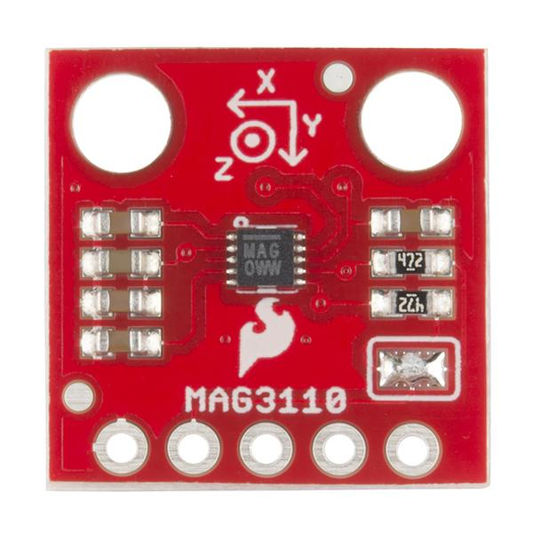
Magnetometer
Responds slowly to change in magnetic field
Detects strength of the magnetic field in the x,y,z axis
Can be used to determine true north
Requires calibration

Slide 12
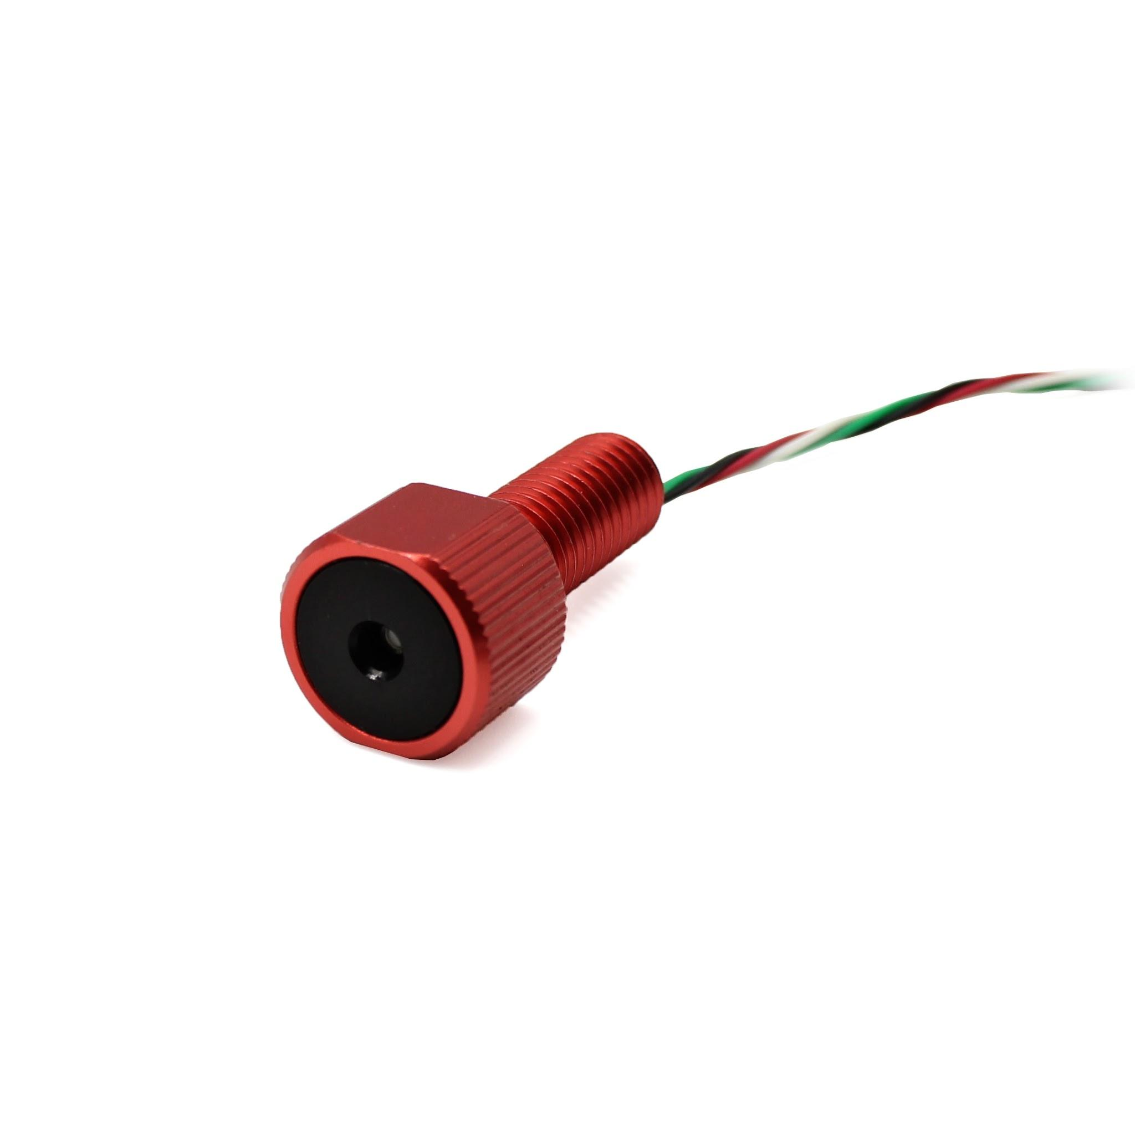
Depth Sensor
Uses pressure to determine depth
Fairly accurate

Slide 13
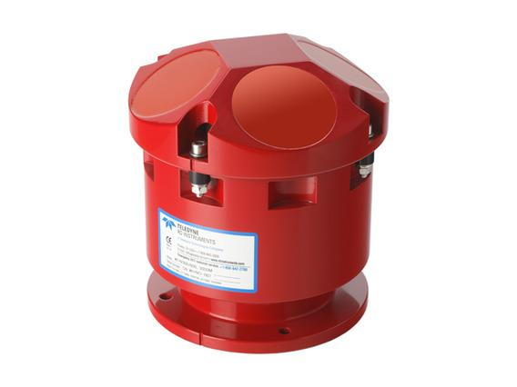
Doppler Velocity Log
Emits a sound ping and waits for its echo
Echo is often of a shifted frequency due to doppler effect
Measures velocity
Expensive

Slide 14
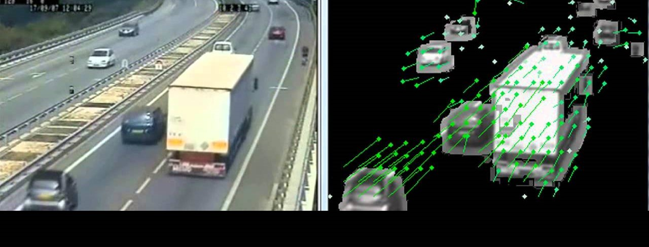
Optical Flow
Cheap. Easy to implement
Can measure velocity

Slide 15
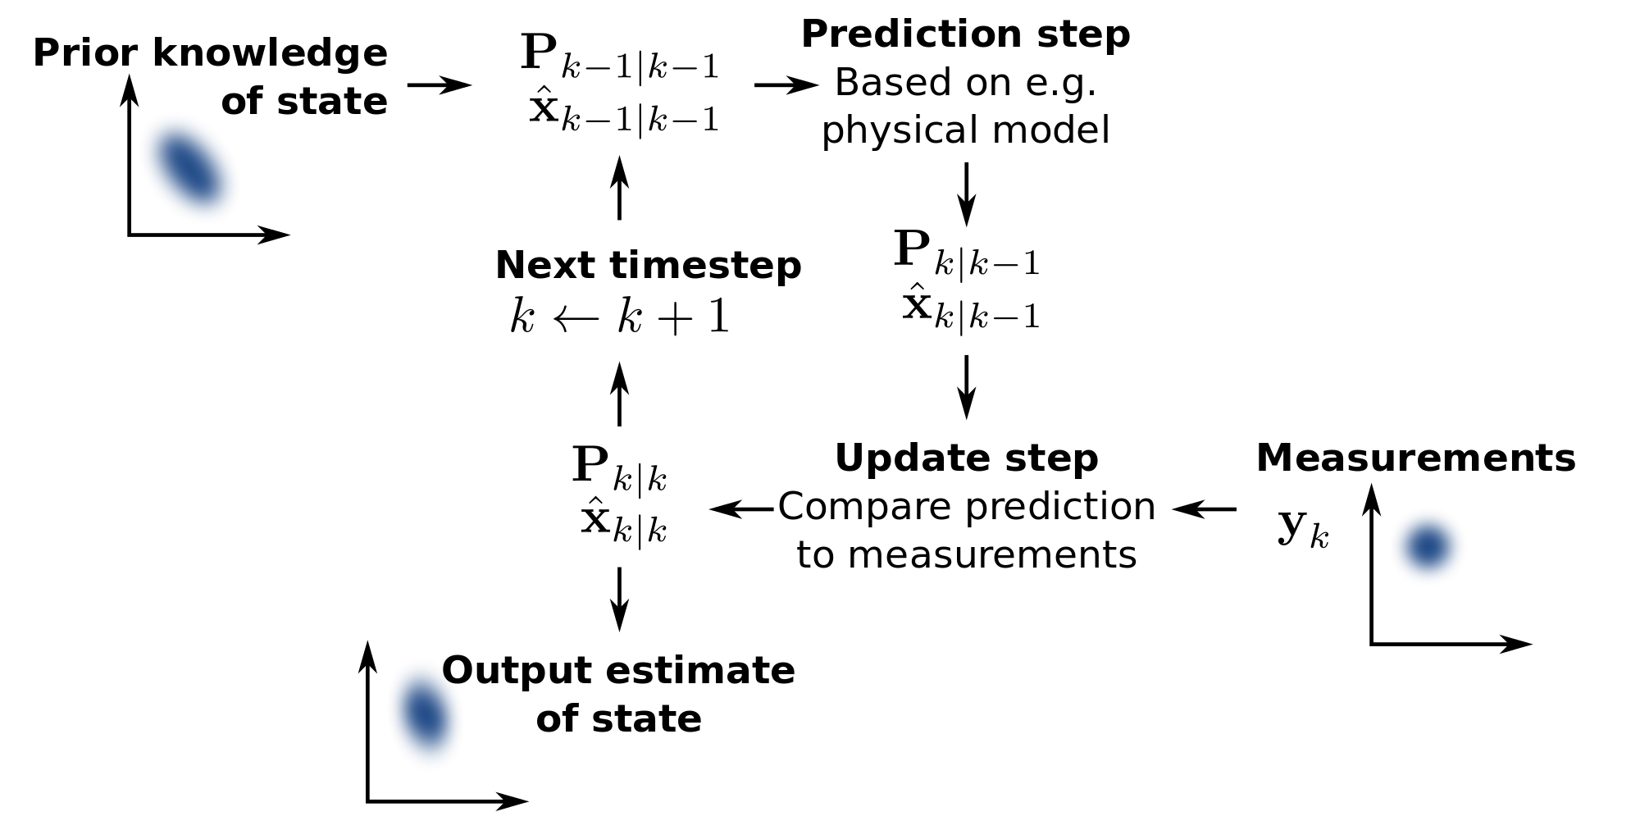
Errors
3) Sensor fusion is performed to correct uncertainties
4) Algorithms are also used:
a) kalman filter
b) madgwick filter
c) particle filter
Sensors have their own set of measurement errors.
Even if these errors are small , they accumulate overtime

Slide 16
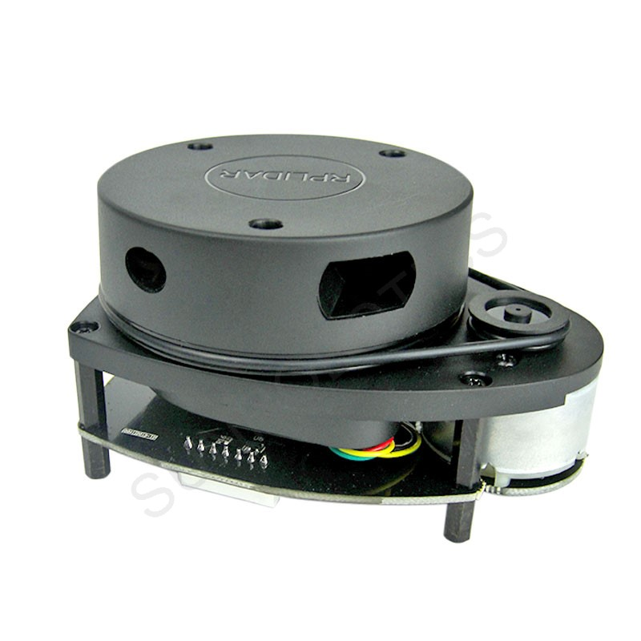
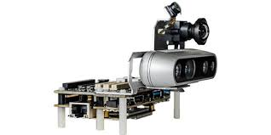
Sensors that understand environment
Camera
Radar/Lidar
Chemical sensors (never used by us before)
Others. Designed specifically for the task that is required to be carried out.

Slide 17
Other uses
Detect internal problems
Pressure
Humidity
Temperature

Slide 18
Controls

Slide 19
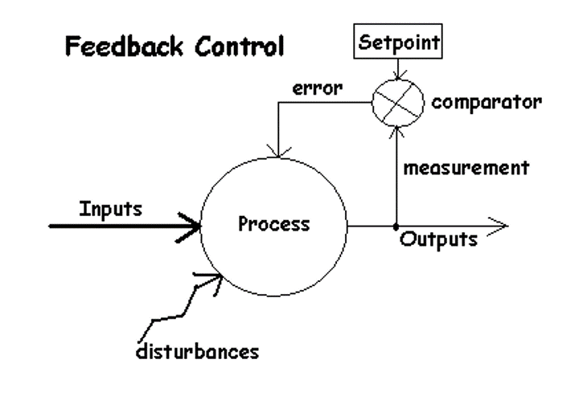
What are controls
•Controls is a vast and complex field in robotics
•Generally we have a controller, a feedback and a setpoint.

Slide 20
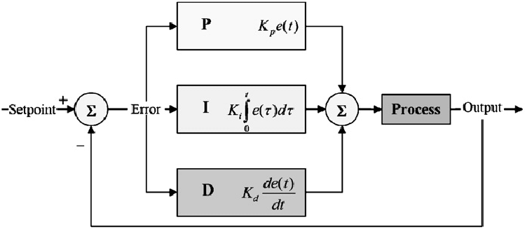
Examples
PID control
Bang-bang
Fuzzy Logic
And many more….

Slide 21
Live Demo

Slide 22
A general guide to tuning PID
Step 1 | Set all the gains to Zero
Step 2 | Increase the P gain until the response to a disturbance is steady oscillation
Step 3 | Increase the D gain until the oscillations goes away (i.e. it's critically damped).

Slide 23
A general guide to tuning PID
Step 4 | Repeat steps 2 and 3 until increasing the D gain does not stop the oscillations.
Step 5 | Set P and D to the last stable values.
Step 6 | Increase the I gain until it brings you to the setpoint with the number of oscillations desired (normally zero but a quicker response can be achieved if you don't mind a couple oscillations of overshoot)

Slide 24
Now it’s your turn!

Slide 25
Assignment 2:
•See the PID control demo in ./assignment2-demo
Todo:
Do not edit simulator.py (you can take a look though)
Add in missing subscribers
PID equation
PID values

Slide 26
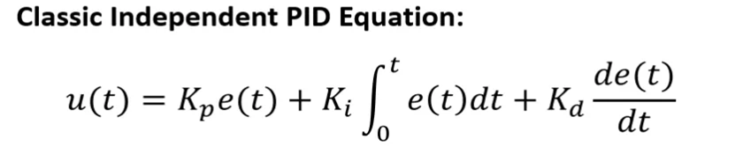
Challenge Yourself: Don’t Google/Stackoverflow the answer.
As we move on to more challenging topics, you are less likely to find a solution online.
Often we only get hints to finding the solution in the form of pseudocode or math equations.
So put your problem-solving skills to the test and try to convert this PID equation into working code.

Slide 27


Slide 28
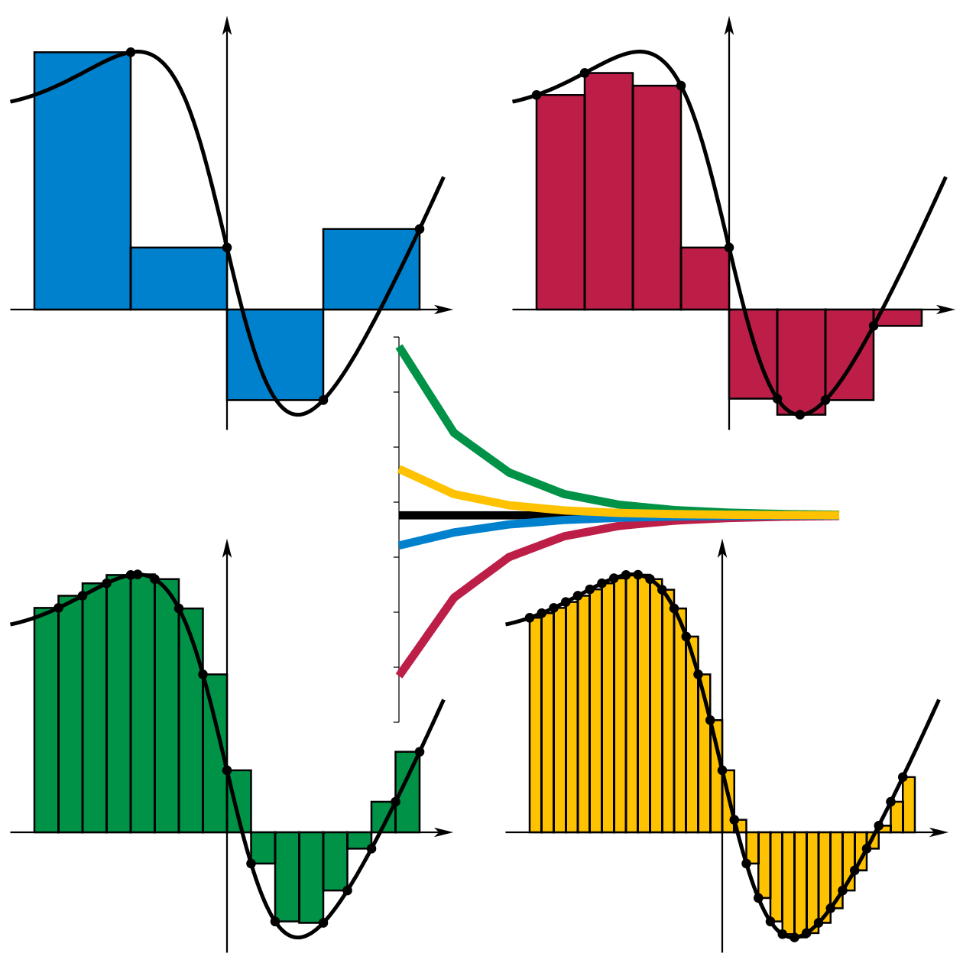
ΔT
∫≈Σ

Slide 29
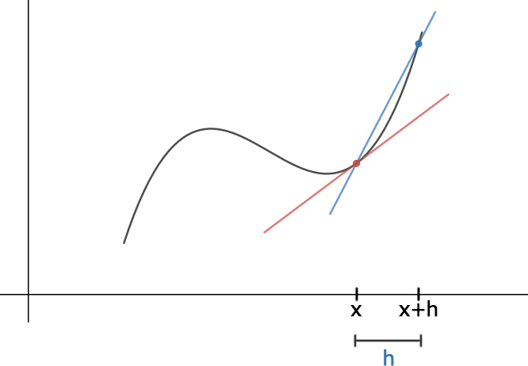
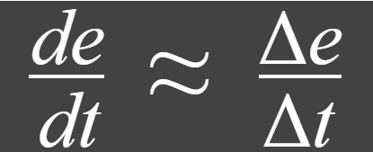
T T+ΔT
Where is ΔT?
ΔT

